Slide 1

Bekaert in brief 贝卡尔特简介

Slide 2
Be the leading partner for
成为引领变革的合作伙伴
Shaping the way
we live and move
塑造生活与出行新方式
safe, smart, sustainable.
安全、智慧、可持续

Slide 3
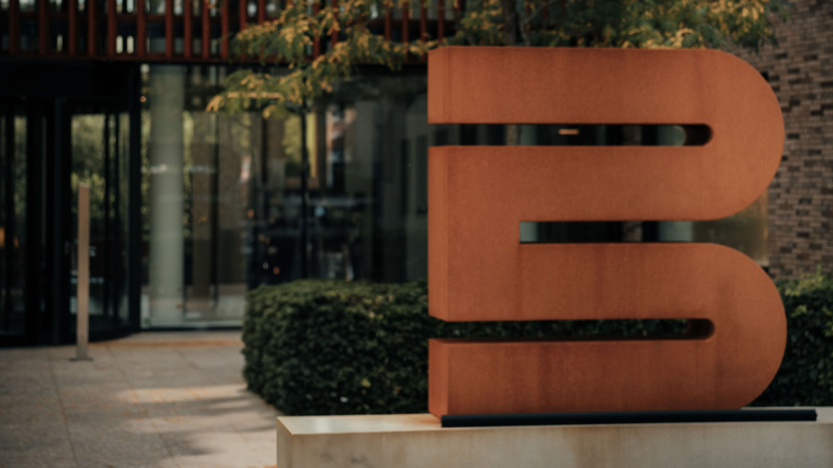
As a global leader in steel wire transformation and coating technologies, we also apply our expertise beyond steel to create new solutions with innovative materials and services for various markets and industries
作为钢丝变形和镀膜技术领域的全球领军企业，贝卡尔特以金属材料科学为核心，持续突破技术的边界。我们不仅深耕钢丝产品创新，更以跨材料解决方案赋能多元市场和行业，为全球客户提供开创性的材料与服务解决方案。
As a global leader in steel wire transformation and coating technologies, we also apply our expertise beyond steel to create new solutions with innovative materials and services for various markets and industries

Slide 4
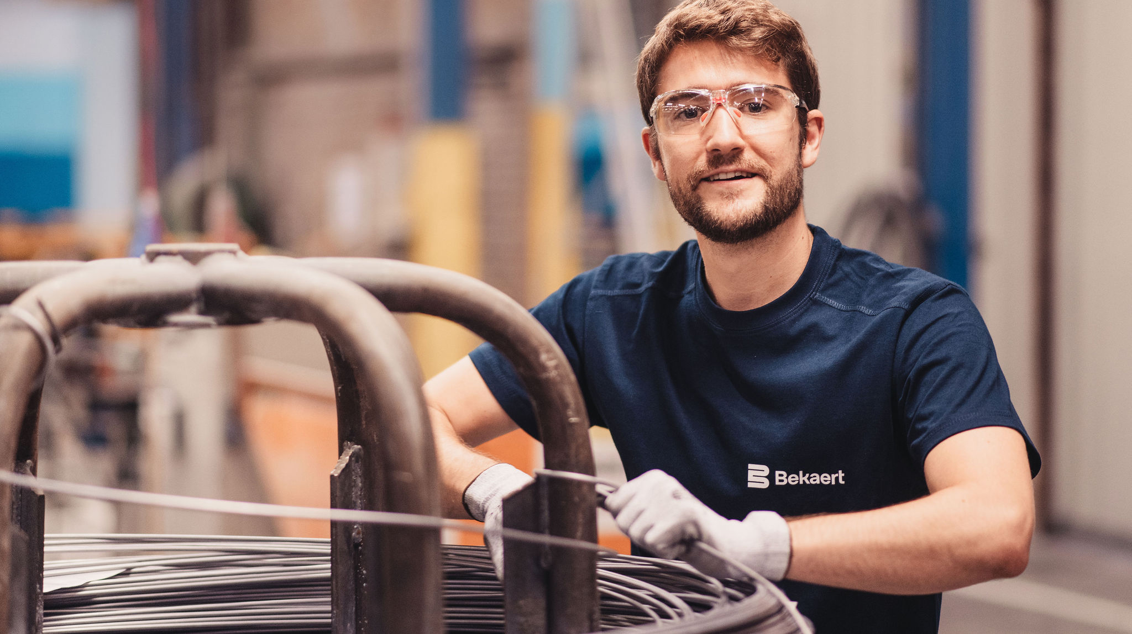
Bekaert at a glance
贝卡尔特，星河一览

Slide 5





Preferred partner serving customers in mobility, sustainable construction, energy transition and others
Worldwide manufacturing platform with 62 production plants
21 000 engaged employees worldwide
Consolidated sales of € 4.0 bn
合并销售额40亿欧元 EBITu € 348 m 基础息税前利润 3.48亿欧元
€ 74 m in R&D
7400万元研发投入
Sustainable company with SBTi validated targets
首选合作伙伴，
专注服务于
移动出行、
可持续建筑、
能源转型
及其他领域。
首选合作伙伴，
专注服务于
移动出行、
可持续建筑、
能源转型
及其他领域。
全球化制造平台，拥有 62 个生产基地。
21000
全球员工
可持续发展企业 拥有科学碳目标倡议（SBTi）认证的目标

Slide 6

Creativity beyond steel 超越钢丝，创新无界
€74 m
R&D in 2024
2024年研发投入7400万欧元
+2 100
Patents
2100多项产品专利
Co-creation合作创新
We join forces with our customers, suppliers, universities and other partners to create innovative solutions
我们与客户、供应商、高校及其他合作伙伴携手，共同打造创新解决方案。
International R&D teams in Belgium – China – UK
国际研发团队（比利时-中国-英国）
Notes:
3 official Bekaert R&D centers: Deerlijk – Jiangyin – Doncaster, but 10 research & engineering sites in total

Slide 7
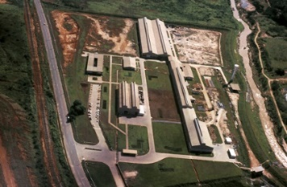
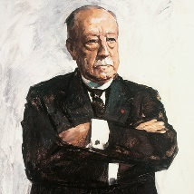
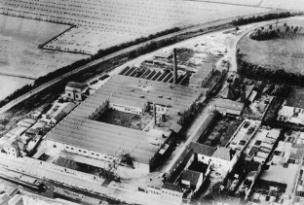
Shaping the way we live and move since 1880
自1880年以来，我们致力于塑造人们的生活与出行方式
Bekaert keeps exploring new territories and starts in Latin America
贝卡尔特不断开拓新市场，进军拉美地区。
Leo Leander Bekaert starts production in Belgium and files first patent one year later
Leo Leander Bekaert先生在比利时创立生产基地，并于次年成功获得首项专利。
Bekaert starts export to North America
贝卡尔特开始探索北美市场。
1880
1922
1928
1945
1950
France is Bekaert’s first expansion outside Belgium
法国是贝卡尔特在比利时本土之外拓展的首个市场。
Great evolution in new technologies: high-carbon steel wire, welded mesh, new coatings and stainless steel wire products for consumer goods
新技术的重大突破：高碳钢丝、焊接网、新型镀膜及不锈钢丝产品，广泛应用于消费品领域。

Slide 8
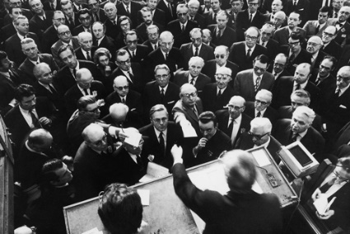
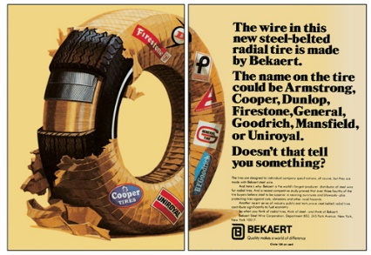
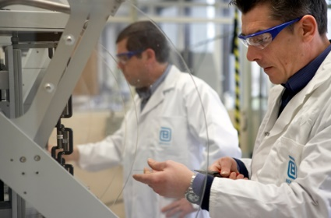
Bekaert is listed on the Belgian stock exchange
贝卡尔特在比利时证券交易所上市。
Bekaert takes its first steps in Asia with a steel cord representative in Tokyo, Japan
贝卡尔特迈出亚洲市场的第一步，在日本东京设立钢帘线代表处。
1951
1957
1964
1970
1972
1973
Opening of 6 new plants, including in the United States.
开设6家新工厂，其中包括在美国的工厂。
Bekaert develops Dramix® steel fibers for concrete reinforcement
贝卡尔特开发Dramix®钢纤维，为混凝土加固提供兼具环境友好和经济效益的解决方案。
Bekaert starts making steel cord for the tire industry
贝卡尔特开始为轮胎行业生产子午线轮胎骨架材料钢帘线。
Bekaert establishes its first R&D center in Deerlijk, Belgium
贝卡尔特在比利时Deerlijk建立了第一个研发中心。

Slide 9

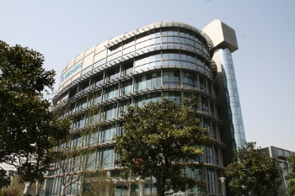

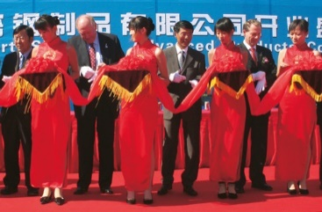
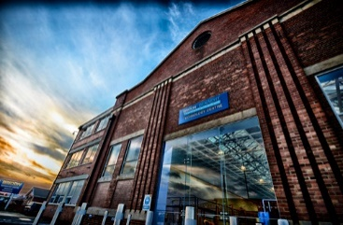
Start of composite activities and steel fiber for filtration
布局复合材料领域，投产过滤用钢纤维产品
Opening of our R&D center in Jiangyin, China
在中国江阴市设立亚洲研发中心。
Bekaert expands its focus on (renewable) energy markets with new products, services, technologies and partnerships
贝卡尔特通过新产品、服务、技术以及合作伙伴关系，深化其在（可再生）能源市场的布局。
1984
1993
2010
2016
2022
TODAY
First investment in China to produce tire cord
在中国投资第一家钢帘线工厂。
Merger of Bekaert and Bridon, including R&D center in Doncaster, UK
贝卡尔特并购布顿集团，包括其位于英国唐卡斯特的研发中心。

Slide 10
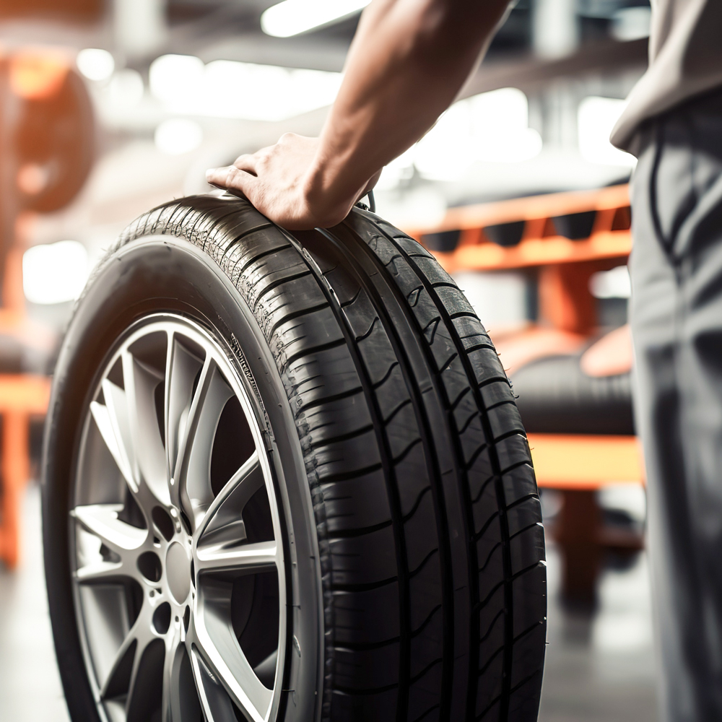
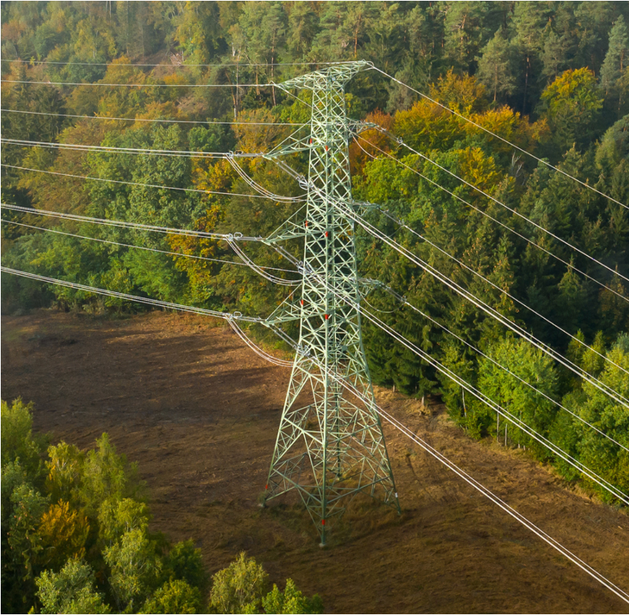
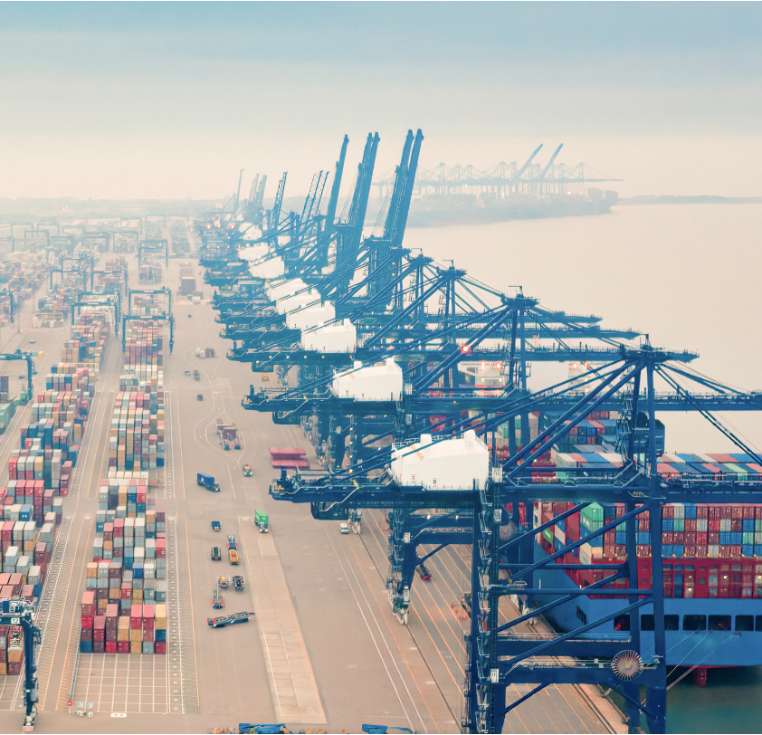
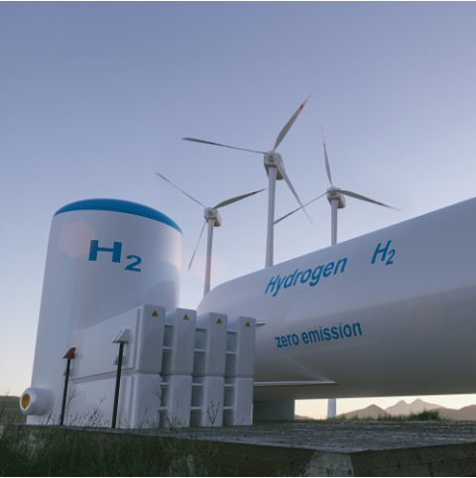
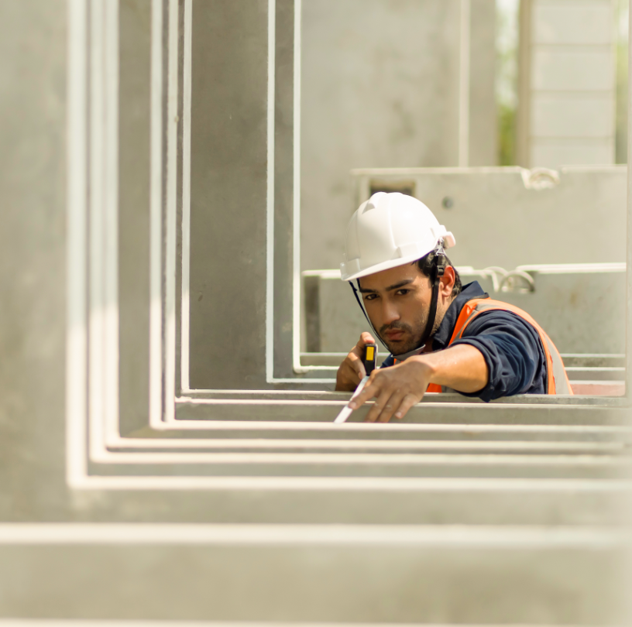
Markets we serve 我们专注的市场领域
Transmission and performance wires
传输和高性能钢丝
Energy transition
能源转型
Tire reinforcement
轮胎骨架材料
Advanced lifting and mooring
先进的起重和系泊系统
Sustainable construction
可持续建筑

Slide 11
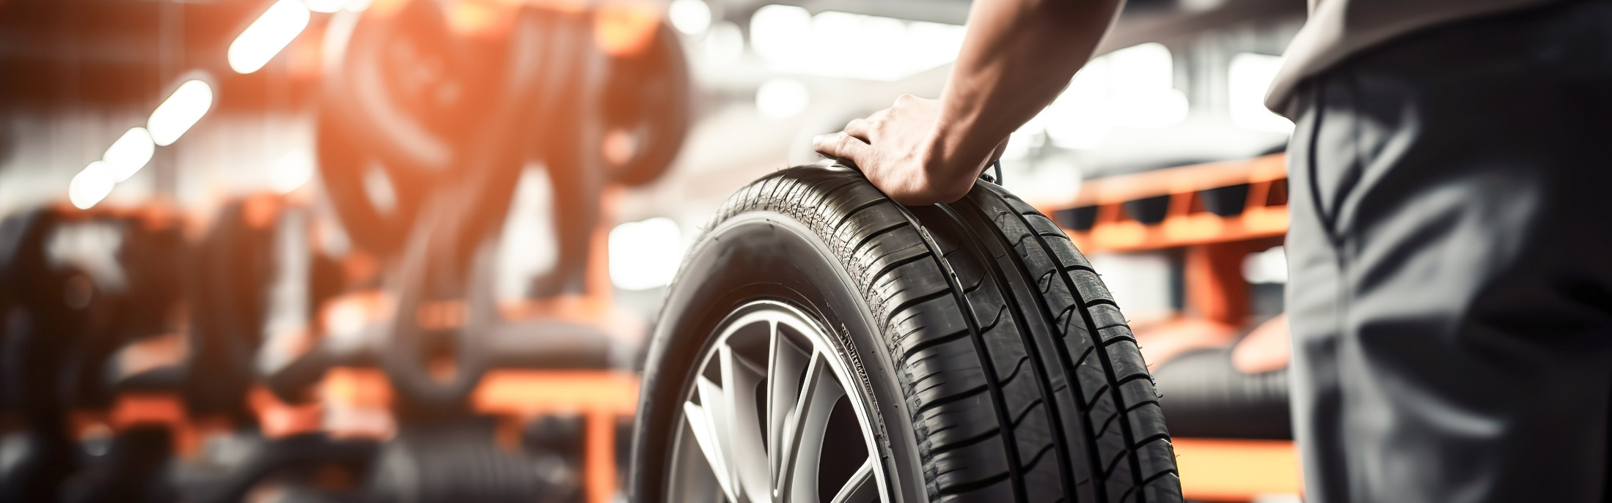

Tire reinforcement
轮胎骨架材料
Transmission and performance wires
传输和高性能钢丝
Advanced lifting and mooring
先进的起重和系泊解决方案
Energy transition
能源转型
Sustainable construction
可持续建筑
Tire reinforcement 轮胎骨架材料
Bekaert reinforces 1 in 4 tires worldwide, setting industry standards for 70+ years.
贝卡尔特为全球四分之一的轮胎提供高性能骨架材料，70多年来持续引领行业标准。
Elyta™: innovative next-gen tire reinforcement for stronger, lighter and more sustainable tires.
优迈特™：新一代创新轮胎骨架材料，打造更强、更轻、更可持续的轮胎。
The only supplier with a global footprint and expert technical support for seamless customer success. 拥有全球业务布局与专业技术支持体系，我们致力于为客户提供无缝衔接的全方位服务，助力其实现商业成功。

Slide 12
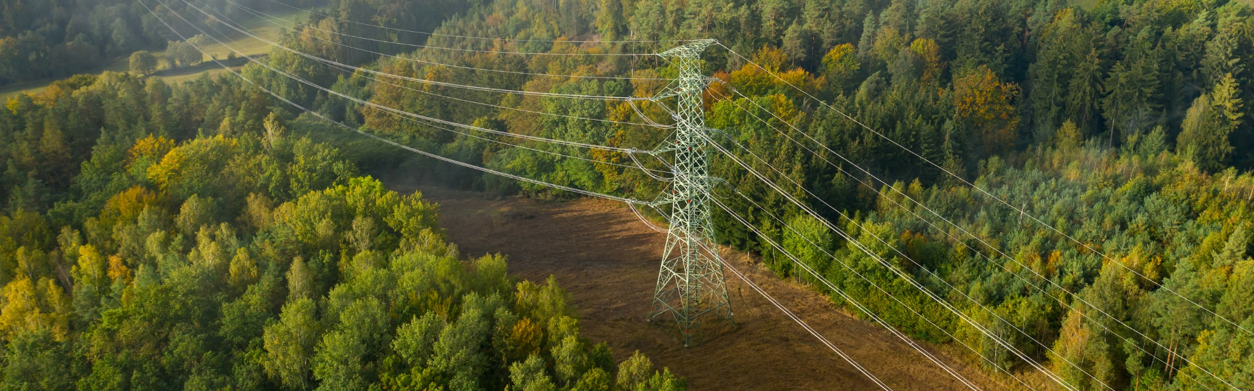
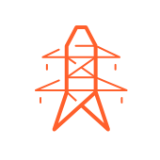
Tire reinforcement
轮胎骨架材料
Transmission and performance wires
传输和高性能钢丝
Advanced lifting and mooring
先进的起重和系泊解决方案
Energy transition
能源转型
Sustainable construction
可持续建筑
Transmission and performance wires 传输与高性能钢丝
Overhead and sub-sea power and data transmission
架空与海底电力及数据传输解决方案
Solutions for automotive sector
面向汽车行业的创新解决方案
Ampact™ to optimize driving range and charging time of Evs
Ampact™：优化电动汽车续航里程和充电时间

Slide 13
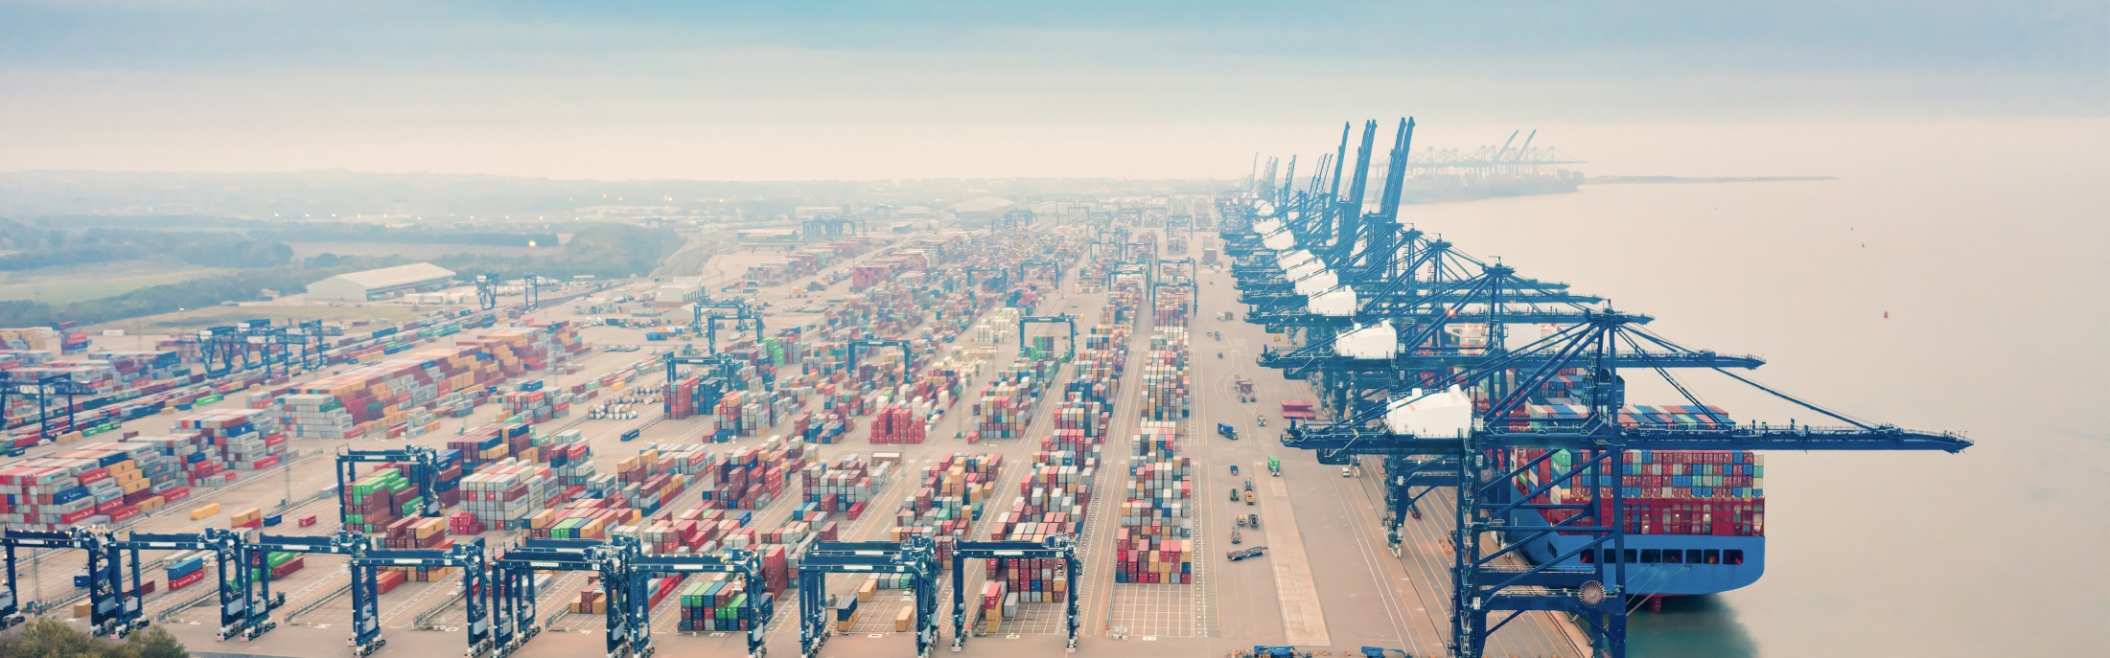

Tire reinforcement
轮胎骨架材料
Transmission and performance wires
传输和高性能钢丝
Advanced lifting and mooring
先进的起重和系泊解决方案
Energy transition
能源转型
Sustainable construction
可持续建筑
Advanced lifting and mooring 先进的起重和系泊解决方案
Bridon® 布顿® steel ropes for use under the harshest conditions 高性能钢丝绳，无惧极端工况考验
Bexco® synthetic ropes for offshore energy and marine applications
合成纤维绳， 为海上能源与海洋应用领域提供专业支持
Notes:
Bridon: cranes & industrial, oil & gas, mining, fishing & marine

Slide 14
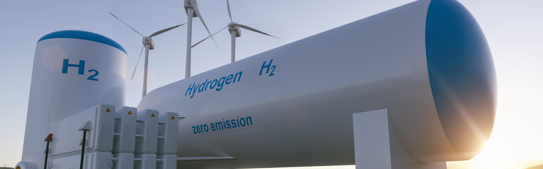

Tire reinforcement
轮胎骨架材料
Transmission and performance wires
传输和高性能钢丝
Advanced lifting and mooring
先进的起重和系泊解决方案
Energy transition
能源转型
Sustainable construction
可持续建筑
Energy transition 能源转型
Currento® porous transport layers for green hydrogen electrolysis applications
Currento® 多空隙传输介质，专为打造更耐久、更高效的绿色氢能电解应用而设计
High-end filtration applications and solutions for automotive glass bending and comfort heating
高端过滤应用以及汽车玻璃弯曲成型、舒适加热的创新解决方案
High precision cutting applications in solar & semicon wafering
太阳能与半导体晶圆领域的高精度切割应用
Burners and heat exchangers for environment-friendly heating solutions
燃烧器与热交换器，为家庭、商业及工业领域提供环保的高效供热解决方案
Reinforcement for high pressure hydraulic hoses and high-end belts
高压液压软管及高端同步带用增强材料

Slide 15


Tire reinforcement
轮胎骨架材料
Transmission and performance wires
传输和高性能钢丝
Advanced lifting and mooring
先进的起重和系泊解决方案
Energy transition
能源转型
Sustainable construction
可持续建筑
Sustainable construction 可持续建筑
From Dramix® (steel fiber concrete reinforcement) to Murfor® Compact (masonry reinforcement)
从 Dramix® (混凝土增强用钢纤维) 到 Murfor® Compact (砌体增强材料)，
Advanced reinforcement solutions that are high-performance, sustainable, safe, economical and reliable.
我们提供高性能、可持续、安全、经济且可靠的先进增强解决方案。
Support from top-tier structural engineering to final quality control.
从顶级结构工程设计到最终质量控制，我们提供全方位的专业支持。

Slide 16



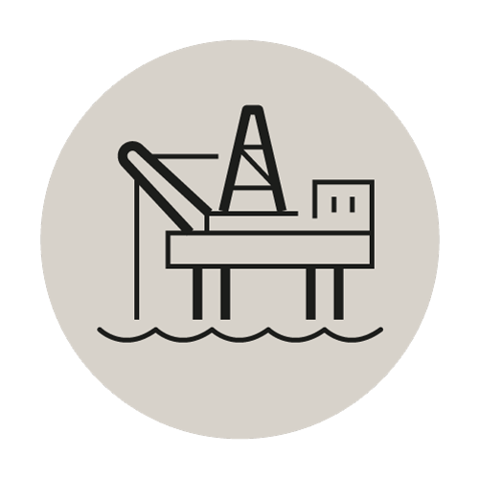
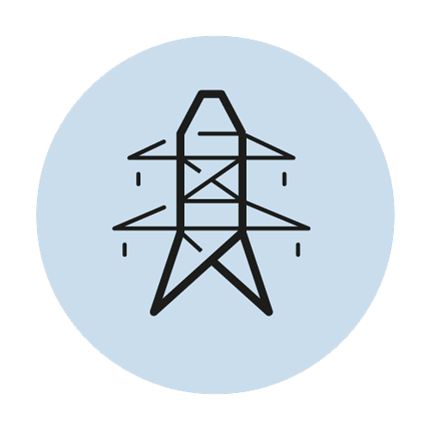
Our chosen markets 我们专注的市场领域
Tire
Reinforcement
轮胎骨架材料
Energy
Transition
能源转型
Sustainable
Construction
可持续建筑
Advanced
Lifting & Mooring
先进的起重和系泊解决方案
Transmission &
Performance wires
传输和高性能钢丝
€7 bn
^{70亿欧元}
€7 bn
^{70亿欧元}
€ 3 bn
^{30亿欧元}
€5 bn
^{50亿欧元}
€3 bn
^{30亿欧元}
Rubber
Reinforcement
橡胶增强事业部
(RR)
Specialty Businesses
特种产品事业部
(SB)
Bridon-Bekaert Ropes Group
布顿-贝卡尔特钢丝绳集团
(BBRG)
Steel Wire
Solutions
钢丝解决方案事业部
(SWS)
Estimated addressable markets by 2030（2030年的市场规模预测）

Slide 17
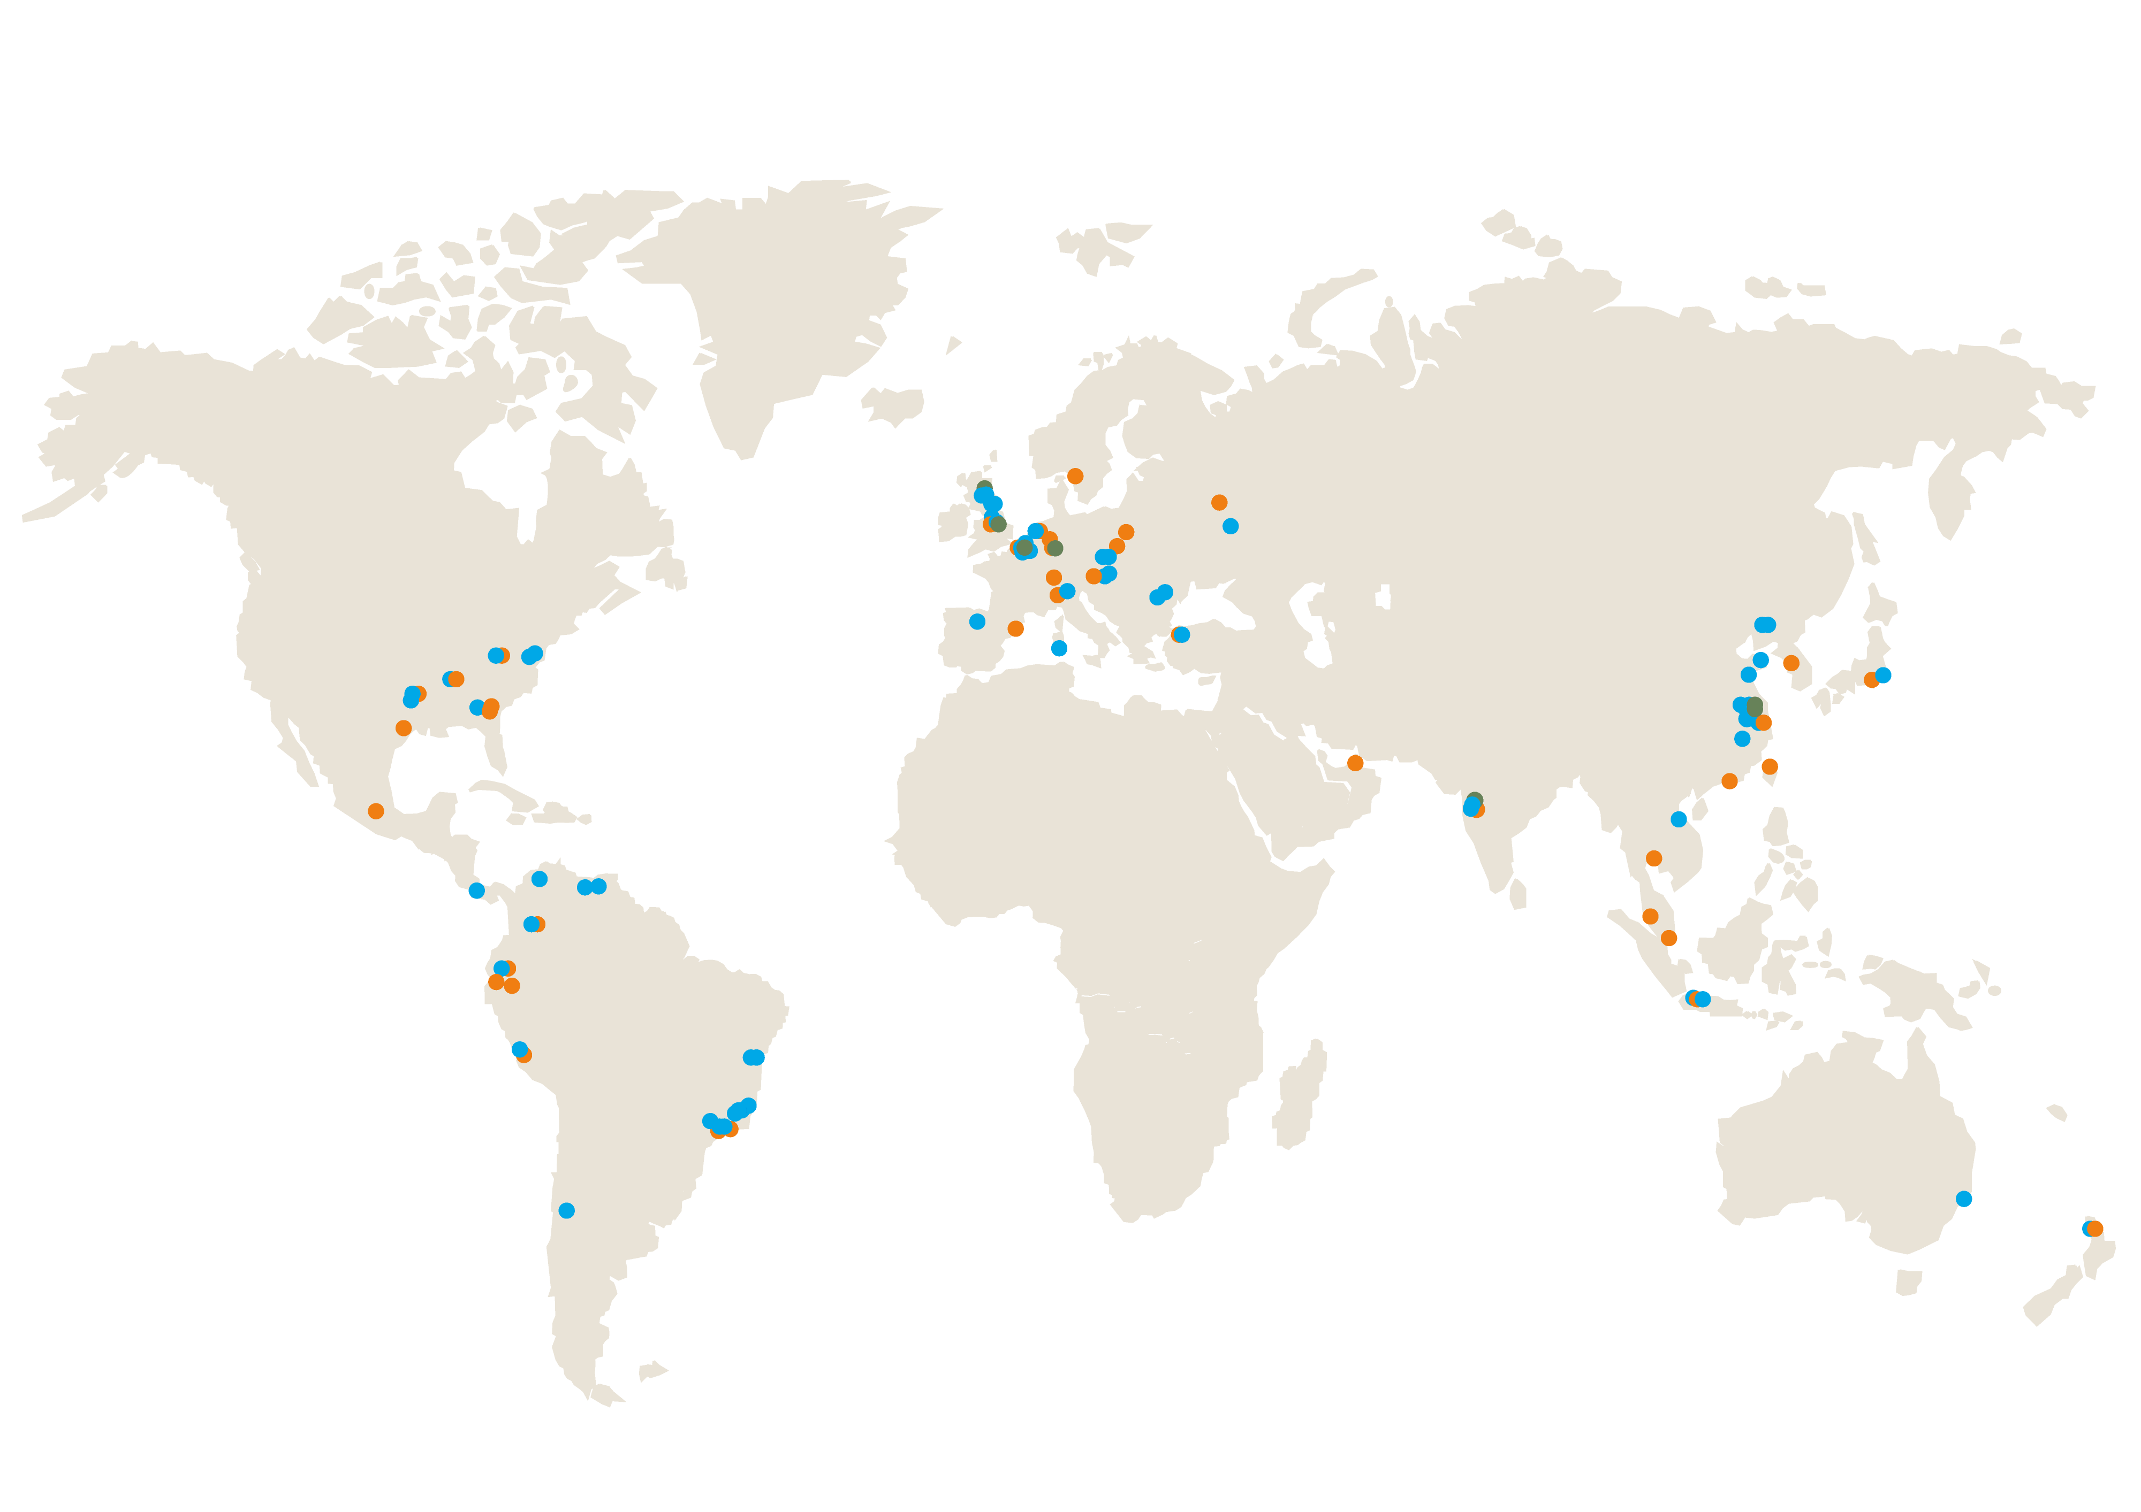
Market proximity 紧贴市场的全球化布局
Bekaert production plants
贝卡尔特生产基地
Bekaert offices
贝卡尔特办公室
Bekaert R&D centers
贝卡尔特研发中心
Notes:
Bekaert operates 69 production plants in 23 countries globally (including joint ventures) + 3 R&D centers
Better together - We are there where you are –
3 official Bekaert R&D centers: Deerlijk – Jiangyin – Doncaster
2 Subsidiary R&D offices in Germany Anspach (Falconix) –UK Dundee - Flintstone

Slide 18
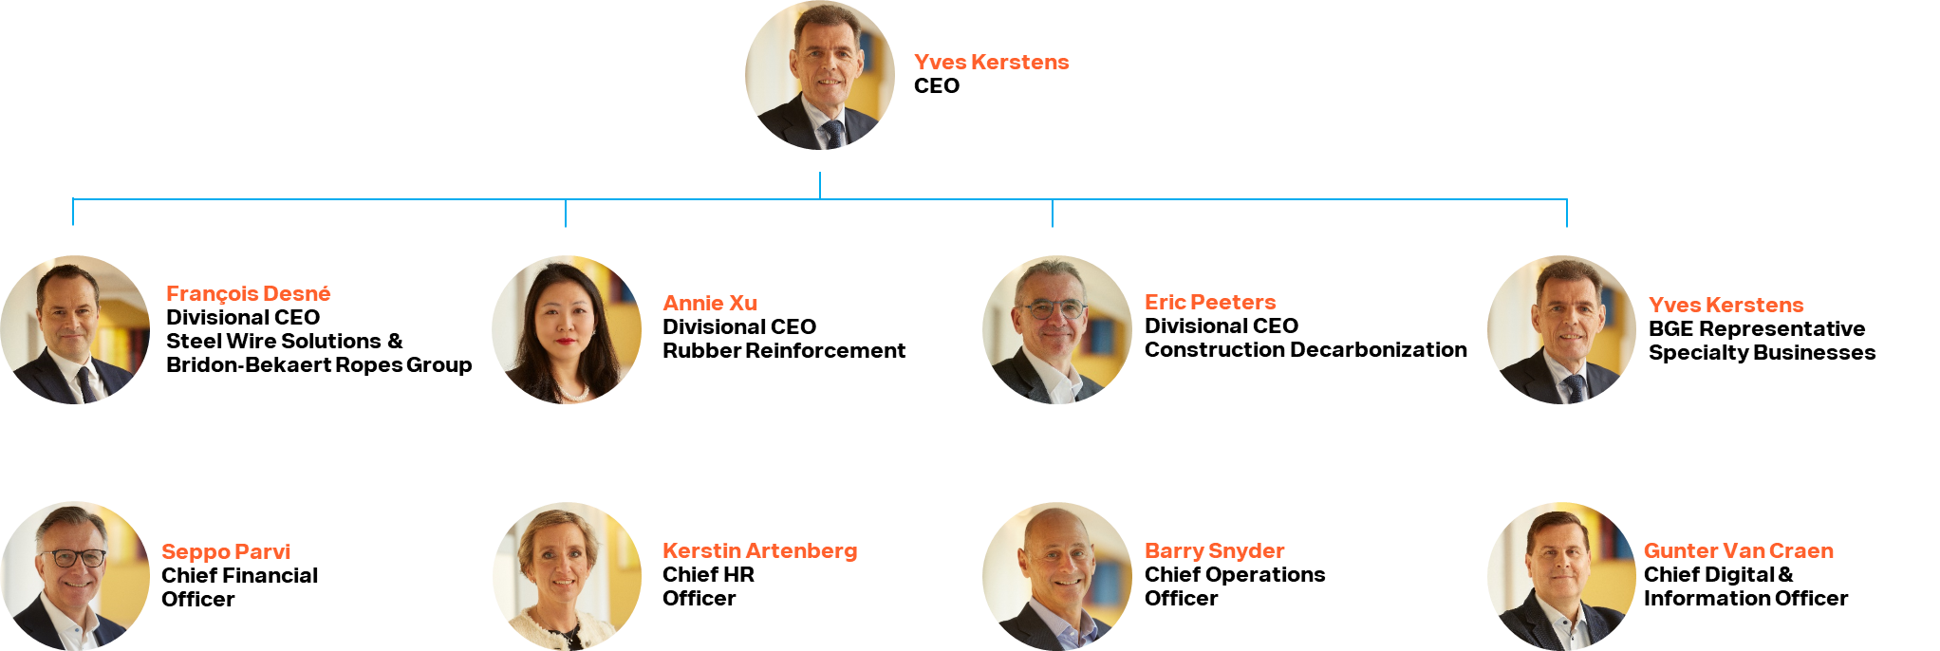
Bekaert Group Executive (BGE) 贝卡尔特集团执行委员会
The BGE is composed of members representing the Business Units and the Global Functions
BGE由事业部门及全球职能部门的核心代表共同组成​
​
首席执行官
事业部首席执行官
钢丝解决方案 &
布顿-贝卡尔特钢丝绳集团
事业部首席执行官 橡胶增强
事业部首席执行官
可持续建筑
BGE 代表 特种产品事业部
首席财务官
首席人力资源官
首席运营官
首席数字与信息官

Slide 19




Creating a better tomorrow
创造更美好的明天
Protect the planet
Put people first
Act with
integrity
保护地球
以人为本
诚信行事
Notes:
We have a clear ambition across all 3 ESG dimensions
Environment: Protect the planet.
We offer products and solutions that embed sustainable practices across their lifecycle and our value chain.
Social: Put people first.
We create a diverse, inclusive and safe environment for our employees and make a positive impact in the communities where we operate.
Act with integrity
We embed transparency and accountability in our collaborative business practices.

Slide 20

Protect the planet 保护地球
Ambition 2030 vs 2019 （2030年目标 vs 2019年基准）
-46,2%
-19.7%
0
-15%
65%
of scope 1&2 GHG¹ emissions in line with science based targets²
基于科学的目标 ，减少范围1&2 的温室气体排放量
of scope 3 GHG emissions from purchased goods and services by 2035²
2035年，减少采购商品和服务所产生的范围3的温室气体排放量
reach carbon net zero by 2050
2050年，实现碳中和
freshwater intake in water stressed regions²
减少缺水地区的淡水使用量
of our sales to be from sustainable solutions
来自可持续解决方案的销售额
2024 Highlights（2024年关键成果）
-20%
-12,5%
250+
-8%
45%
reduction in Scope 1 & 2 GHG emissions
减少范围1&2的温室气体排放
reduction in scope 3 GHG emissions from purchased goods and services²
减少采购商品和服务所产生的范围3的温室气体排放
energy saving initiatives implemented via You Know Watt
开展You Know Watt节能减排项目
less freshwater intake in water-stressed regions²
减少缺水地区的淡水使用量
sales from sustainable solutions
来自可持续解决方案的销售额
¹GHG: Greenhouse Gas, ²vs 2019

Slide 21

Put people first 以人为本
Ambition 2030（2030年目标）
40%
100%
0
100%
female representation in administrative and managerial workforce
行政和管理人员中的女性占比
commitment to create a positive working environment for all our employees
承诺为所有员工创造积极的工作环境
No harm to anyone
全员无伤害
commitment to actively engage with communities on priority sustainability themes
围绕重点可持续发展议题，与社区开展积极互动
2024 Highlights（2024年关键成果）
29%
37
Assistance ^{Program}
^{员工关爱计划}
Safety First
20 000+ ^{employees}
^{员工}
female representation
行政和管理人员中女性占比
rolled-out to all employees
面向全体员工，开展心理健康、财务与法律咨询等全方位的保障服务
average training hours per employee
员工人均培训时长
multiple safety awareness campaigns and enhanced life-saving-rules
开展多项安全宣传活动并强化生命安全准则
actively supporting communities in 40+ countries
在40多个国家积极开展社区支持行动

Slide 22

Act with integrity 诚信行事
Ambition 2030 （2030年目标）
Strong
100%
100%
Partner
100%
compliance management
严格的合规管理
of strategic suppliers to be leading in ESG ratings
战略供应商达到行业领先的ESG评级
of spend with suppliers who sign off code of conduct
与签署《行为准则》的供应商合作
with suppliers and customers across the value chain
与价值链的客户和供应商们合作
transparent and integrated reporting
透明和综合的报告系统
2024 Highlights（2024年关键成果）
100%
51%
94%
External ^{recognition荣誉}
CSRD ^{compliance合规}
of Bekaert PC users signed Code of Conduct
贝卡尔特全体电脑用户均已签署《行为准则》
of strategic supplier spend with Ecovadis score 45+
战略供应商达到Ecovadis铜牌级（45分）以上的标准
spend with suppliers committing to Code of Conduct Supplier
供应商签署《行为准则》
listed in Time’s Top 500 Most Sustainable Companies and recognized by ESG ratings
荣膺《时代周刊》全球500强最具可持续发展企业榜单，并获得ESG评级机构权威认可
CSRD-compliant reporting under limited assurance
根据CSRD要求编制报告，设置了独立鉴证机制

Slide 23
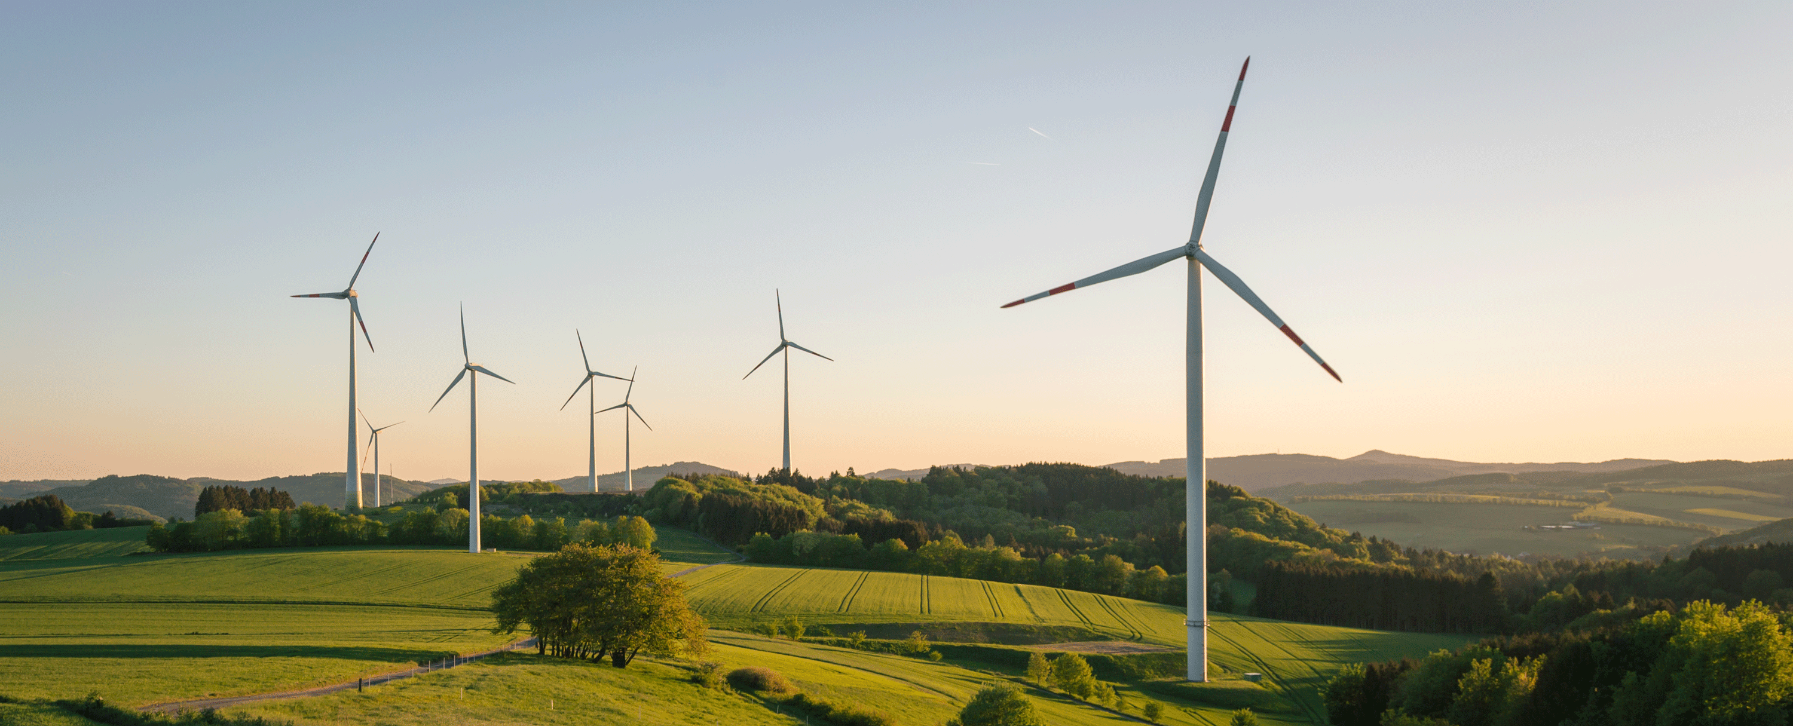

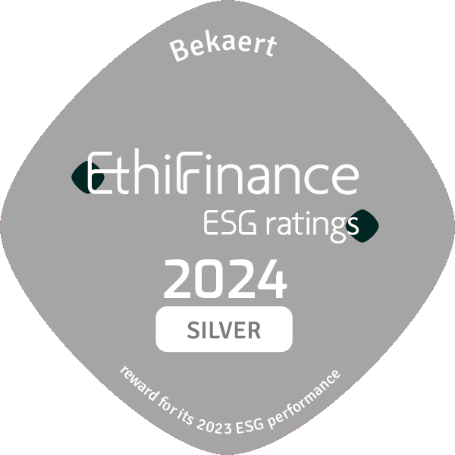

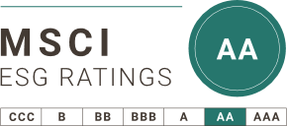
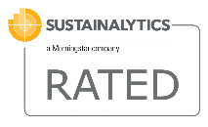

Our sustainability ratings 我们的可持续评级
https://www.bekaert.com/en/sustainability/sustainability-standards
Notes:
You can find the latest ratings on this website: https://www.bekaert.com/en/sustainability/sustainability-standards

Slide 24
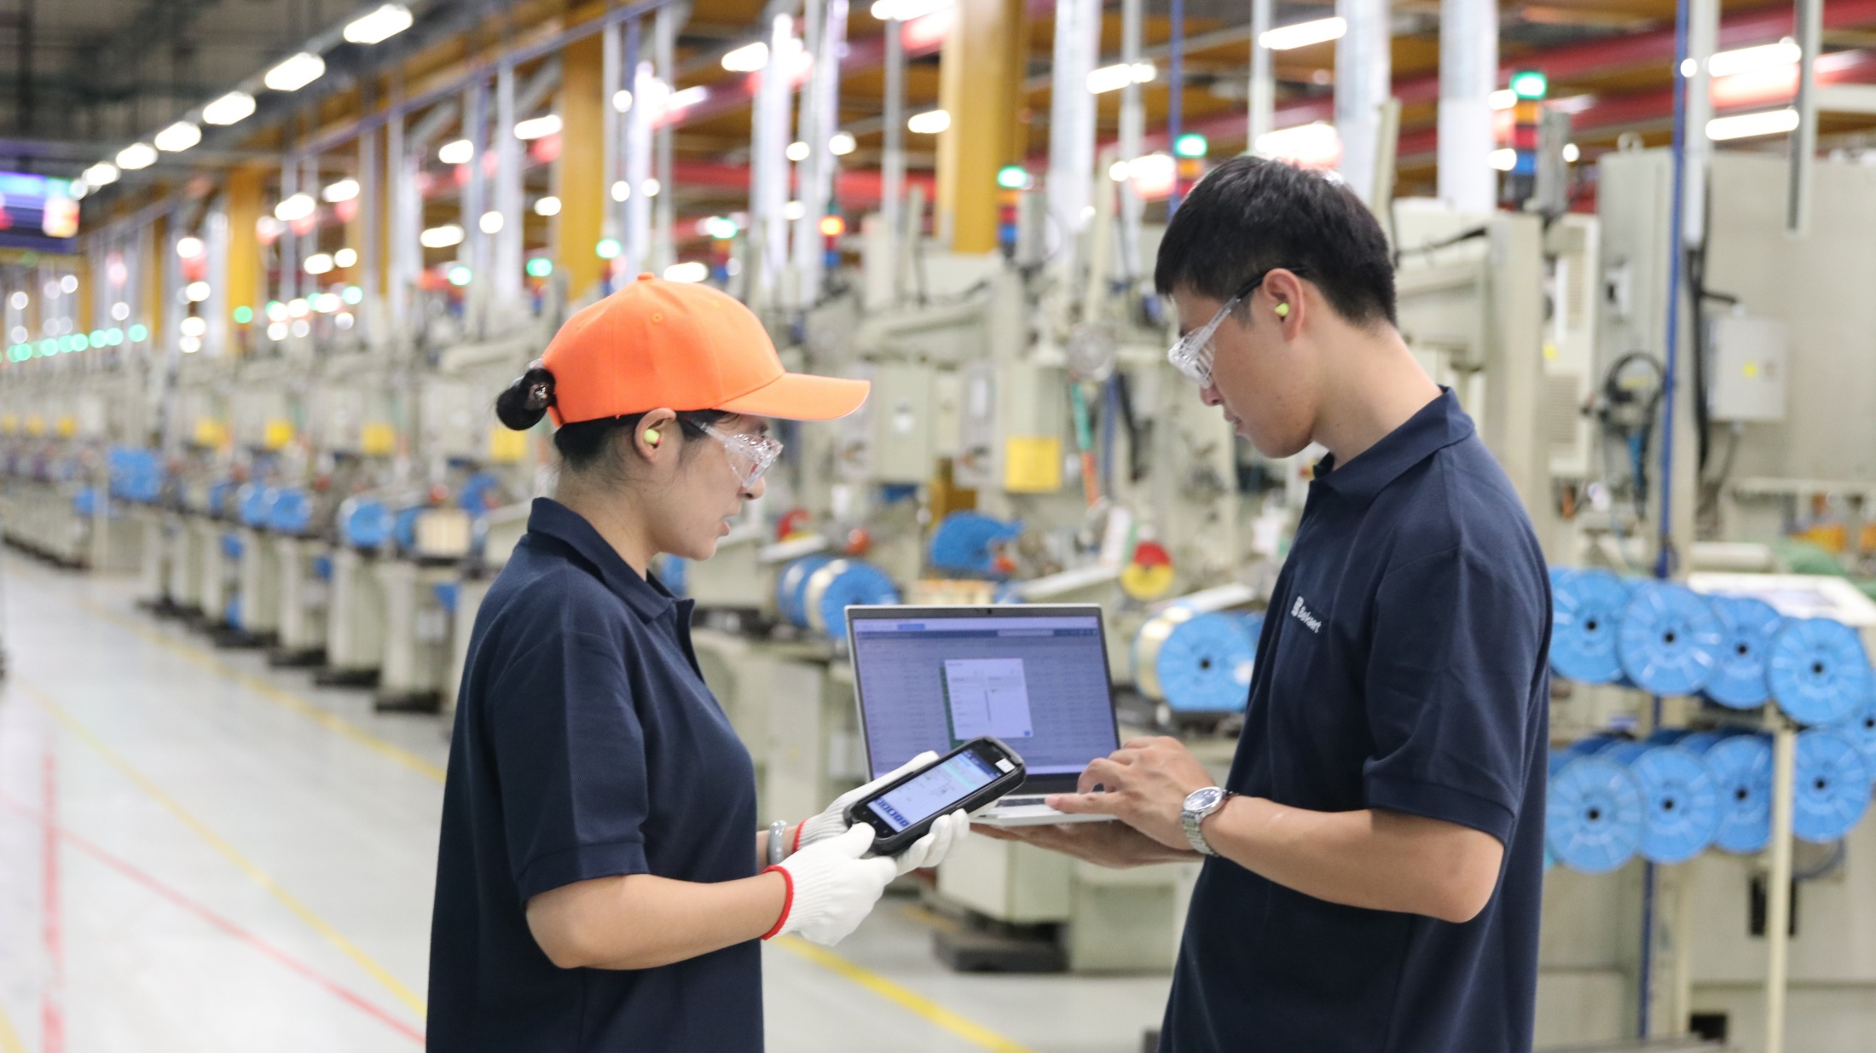
Bekaert in China 贝卡尔特在中国

Slide 25




Bekaert China at a glance 贝卡尔特中国概览
EMPLOYEES
员工
PRODUCTION
SITES
生产基地
R&D/ENGINEERING ITES
研发/工程中心
INVESTMENT
累计总投资
€1.5 bn
15亿欧元
6500
13
2
Notes:
NAM:
1 622 (employees)
9 (sites)
LAM:
3 441 (employees)
12 (production sites)
1 (main research & engineering sites)
Brazil circle (JV):
3365 (employees)
10 (production sites)
EMEA:
8 187 (employees)
23 (production sites)
5 (main research & engineering centers)
ASIA PACIFIC:
10 365 (employees)
21 (production sites)
4 (main research & engineering sites)
Subsidiaries: 23 615 employees – 65 production sites – 10 main research & engineering sites
Joint ventures in Latin America: 3365 employees – 10 manufacturing plants
Combined: 26980 employees – 75 production sites – 10 main research & engineering sites

Slide 26




We’re where you are 我们就在您身边
Operations across 7 cities 运营分布7个城市
Localized innovation 本土创新
From global to local: synergizing R&D and manufacturing facilities in China
亚洲研发中心与生产基地协同创新，推动技术本地化转化
Region-tailored solutions 区域定制化解决方案
Stay close to our customers, offering tailored product portfolios for diverse market segments
贴近我们的客户，针对不同细分市场，提供差异化产品组合
Distributed production network 分布式制造网络
Local supply chains, agile customer response
本地化供应、灵活响应客户需求
Bekaert production plants
贝卡尔特生产基地
Bekaert offices
贝卡尔特办公室
Bekaert R&D centers
贝卡尔特研发中心
Culture proximity 文化亲近
Maintain close communication and efficient collaboration with customers and partners
与客户、合作伙伴保持密切沟通，高效协作
沈阳
Shenyang
威海
Weihai
青岛
Qingdao
江阴
Jiangyin
上海
Shanghai
苏州
Suzhou
杭州
Hangzhou

Slide 27
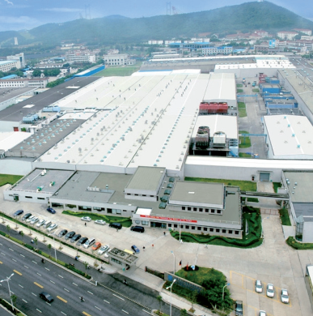
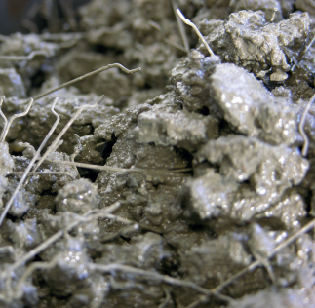

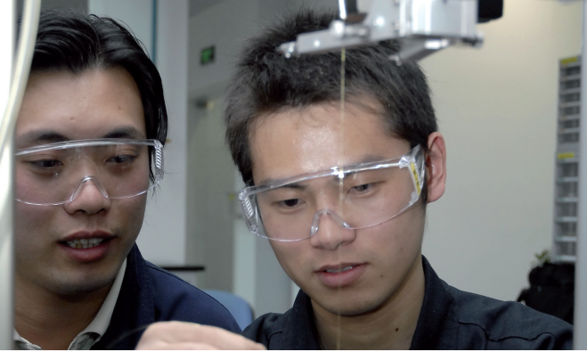
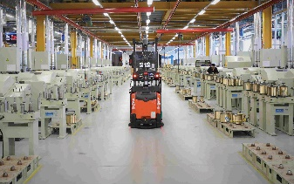
Three decades of shared growth with China 三十三载，与中国共成长
Bekaert invests the first stee cord plant in Jiangyin and opens the representative office in Shanghai.
贝卡尔特在中国江阴投资第一家钢帘线工厂，并在上海设立了代表处。
First investment in China to produce Dramix® for concrete reinforcement.
贝卡尔特在中国开始生产混凝土增强用佳密克丝®钢纤维。
Produce and develop steel fibers for automotive, filtration, hydrogen, and more.
生产和开发金属纤维制品，广泛应用于汽车、过滤、制氢等行业。
1992
1996
1997
1998
2004
Bekaert establishes its engineering and center in China.
贝卡尔特在中国设立工程技术中心。
Opening plants in Shenyang, Weihai, Shanghai, Suzhou, Jiangyin and Qindao since 1998, bringing the leading steel wire products and technology to China market.
从1998年开始，陆续在沈阳、威海、上海、苏州、江阴、青岛等地建立工厂，将世界领先的钢丝产品和技术引入中国市场。

Slide 28
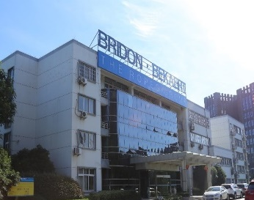
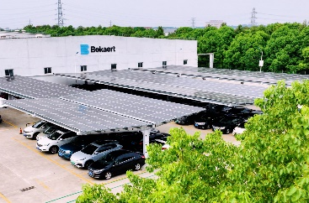
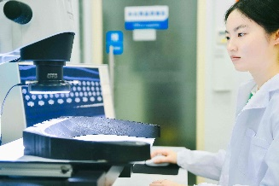
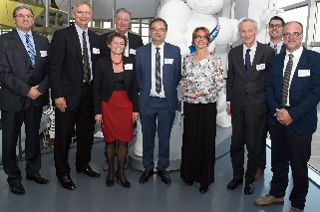


Bridon and Bekaert merged the rope and advanced cord businesses.
布顿和贝卡尔特合并钢丝绳和先进帘线业务，增强起重和系泊领域的竞争实力。
Bekaert Jiangyin plant awarded National Green Factory .
贝卡尔特江阴工厂荣获国家级绿色工厂称号。
2010
2016
2018
2022
2023
Today
Bekaert wins the Michelin Supplier Award 2018.
贝卡尔特荣获米其林2018年度最佳供应商奖。
Bekaert launches a new strategy and brand to lead future solutions.
贝卡尔特启动全新发展战略与品牌，引领未来解决方案。
Opening of Asia R&D Center, with focus on Asian customers to meet their innovation needs.
成立亚洲研发中心，更注重对亚洲客户的承诺，以满足其创新需求。

Slide 29

Sustainability in action, for a better tomorrow 可持续行动，共创美好明天
Protect the planet
保护地球
Energy efficiency
能效管理
“You Know Watt”
Renewable energy
可再生能源使用
Circular economy & resource management
循环经济与资源管理
Sustainable solutions
可持续解决方案
Collaboration & synergy
合作与影响力
80% factory coverage/
100% employee training
80%工厂覆盖/100%员工培训
600+ identified energy improvement projects
600+能源提升项目
-8% of energy intensity
vs. -15% by 2030
-8%能源强度vs.-15%(2030)
Green power:22GWh(2024)
绿电购买：22GWh(2024)
30MW rooftop solar station in Jiangyin
30MW江阴屋顶光伏电站建成
Reducing carbon emissions by about 30,000 tons/year
每年减少约30000吨碳排放
13% water reduction
vs.15% by 2030
淡水使用量减13% vs.15%(2030)
100% recycled steel scrap
100%钢铁废料回收利用
Scaling High Recycled Content(HRC) in raw materials
推动回收钢在原材料的应用
Focuses: energy transition, new mobility, and sustainable construction
聚焦能源转型、新移动和可持续
建筑等关键领域
ElytaTM for PCR/LTR tire reinforcement, Dramix® for concrete reinforcement…
创新低碳解决方案：新一
代轮胎骨架材料优迈特TM, 佳密
克丝®混凝土增强解决方案等
Drive sustainable transformation across and beyond the value chain
推动上下游价值链可持续转型
“Green Supply Chain
Management Award”
第二届中国企业碳中和表现榜
——绿色供应链管理奖

Slide 30



Sustainability in action, for a better tomorrow 可持续行动，共创美好明天
Put people first
以人为本
No-harm-to-anyone
全员无伤害
“BeCare”
DE&I
多元和包容文化
Learning & development
学习和发展
Creating a positive workplace
打造积极向上的工作氛围
BeCare, our global safety excellence program
BeCare全球安全卓越计划
Embedding SHE in our organization
将SHE理念深植于组织运营中
Developed a clear diversity, equity, and inclusion strategy and approach
制定清晰的多元、公平、包容的发展战略
和执行方案
Launching global campaign focusing on cultural diversity: #Say My Name
发起聚焦文化多样性的全球项目, 例如：
#Say My Name
Learning Friday
周五学习日
LinkedIn Learning Platform
领英学习平台
Leadership Programs
领导力项目
Employee Assistant Program(EAP）
员工关爱计划
Bekaert Wellbeing Week
贝卡尔特身心健康周
A variety of employee engagement initiatives 丰富的员工活动

Slide 31
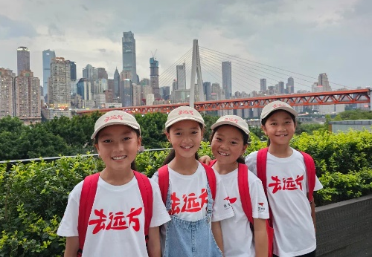
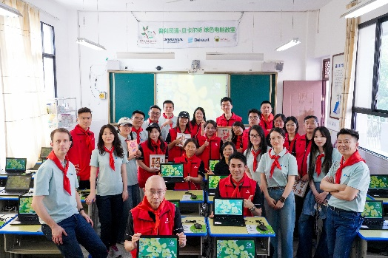
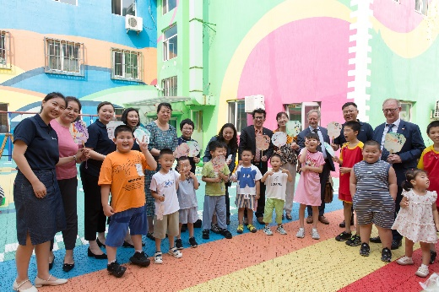
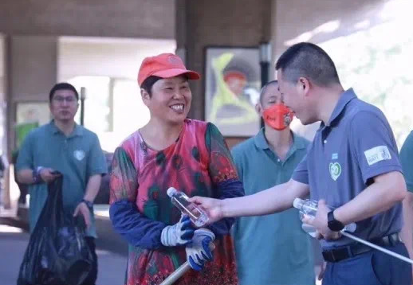
Active community engagement 社区活动
Going Faraway
去远方
Supporting children from rural areas to explore the world
携手真爱梦想基金会，支持偏远地区的孩子实现去远方的梦想
Green Computer Classroom
绿色电脑教室
Partnering with Bridgestone to help children in rural areas access quality educational resources.
携手普利司通，助力偏远地区儿童共享优质教育资源
Qizhi Kindergarten
启智幼儿园
Bekaert Shenyang: 25 years’ continued care & support for special children.
贝卡尔特沈阳工厂持续25年关爱特殊儿童
Green Initiatives
绿色环保活动
Launching You Know Watt to bring greener mindset to the community.
开展You Know Watt ，将绿色理念带进社区
Notes:
Our focuses: children's education, safety, and environmental protection
重点关注儿童教育、安全和环保

Slide 32
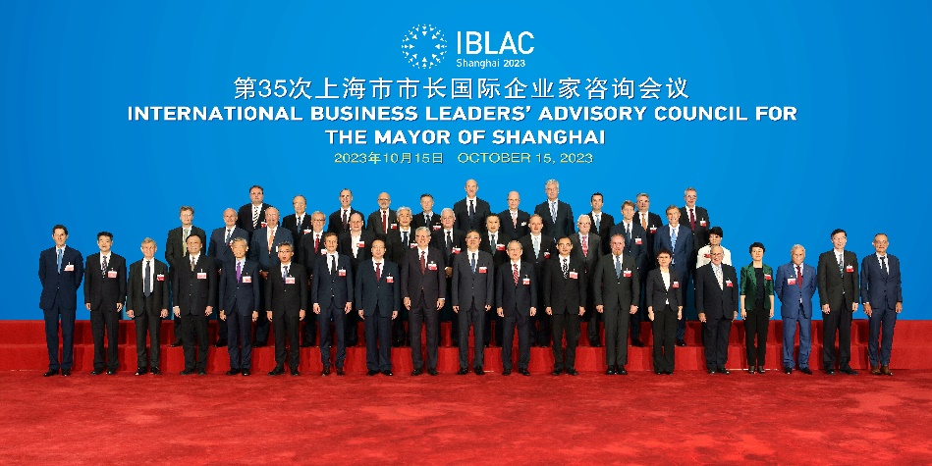
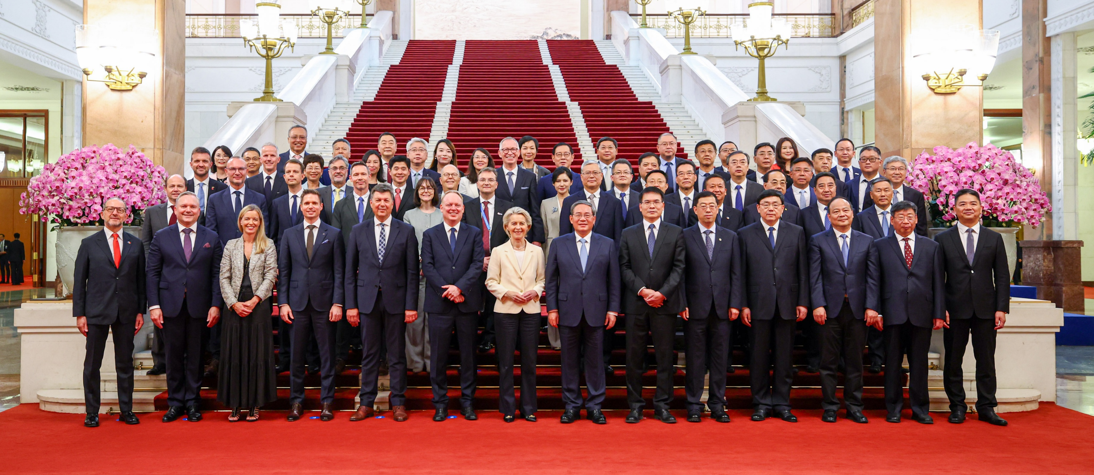
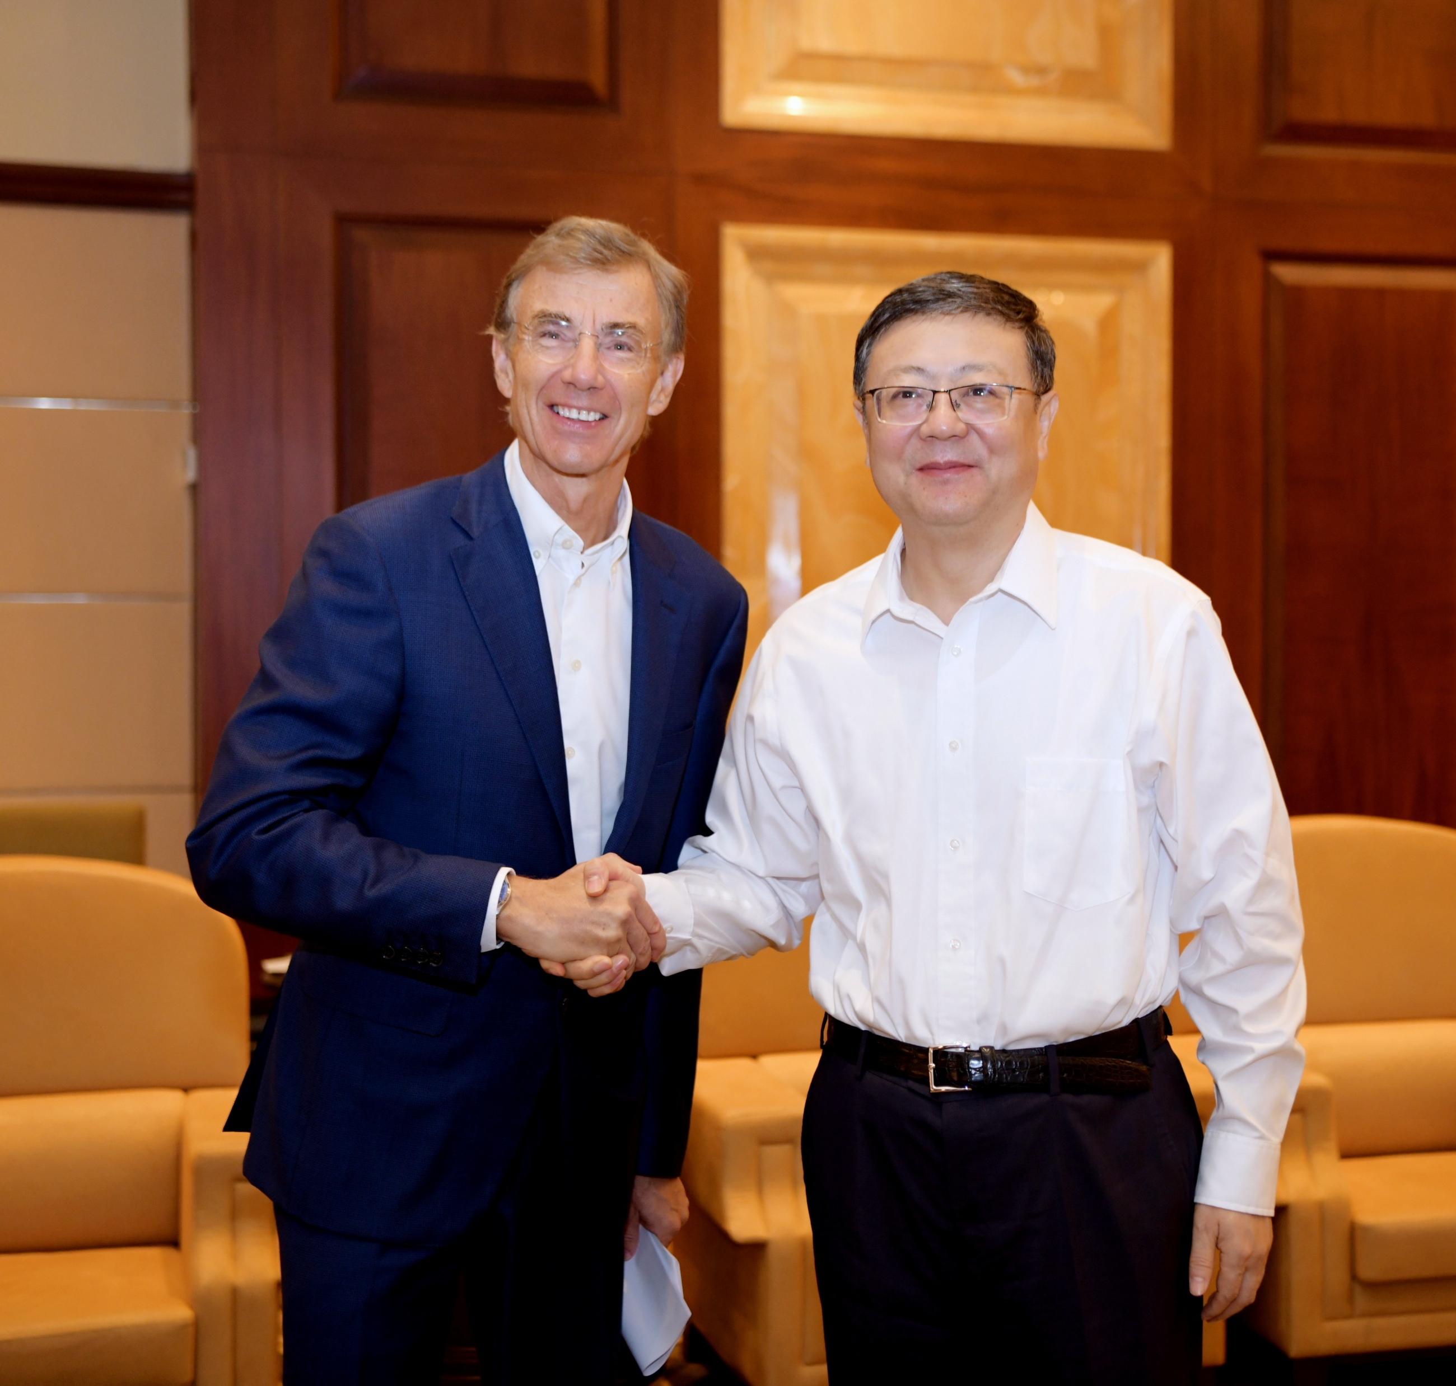
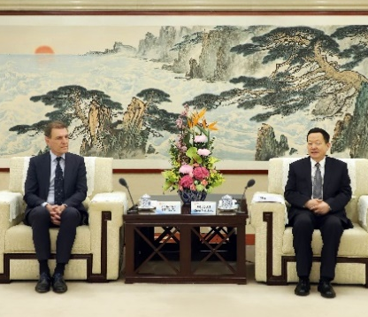
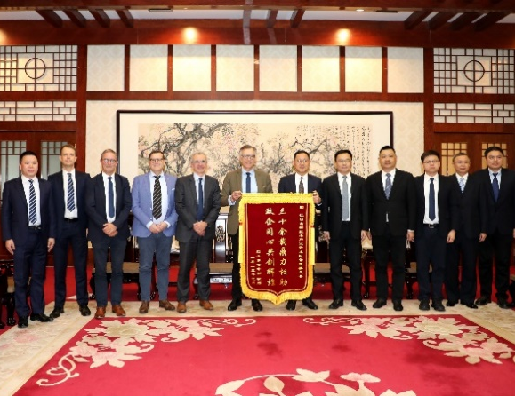
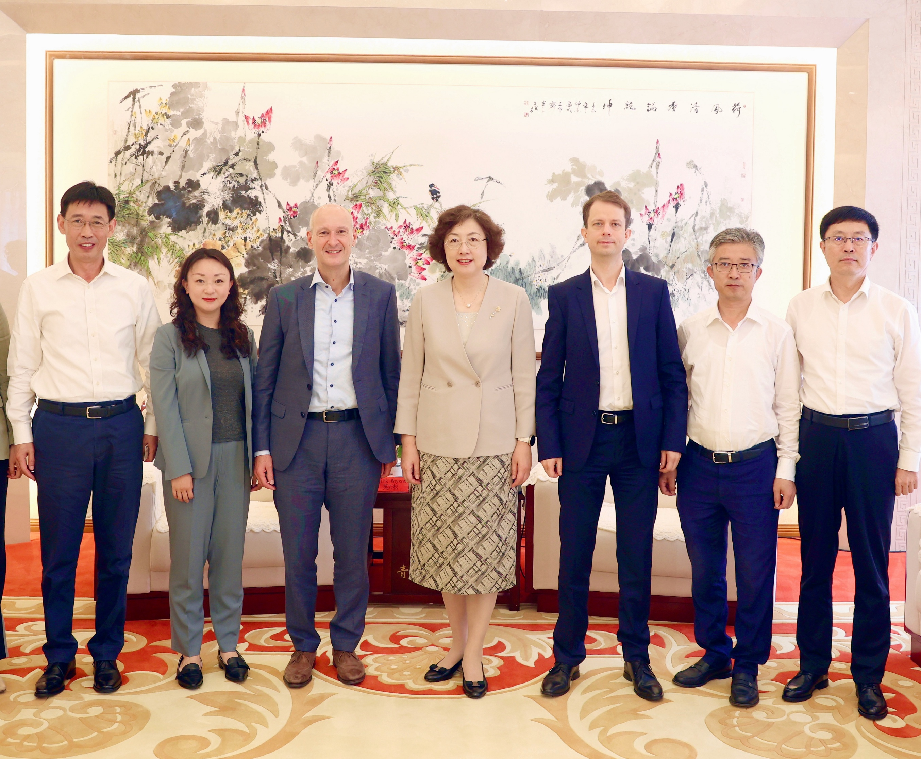
Win-win government engagement 政企协同，共谋发展

Slide 33

Awards and recognition 荣誉与认可
2022
2023
2024
2025
China Outstanding Patent Award
中国优秀专利奖
Tire Manufacturing Innovation of the Year(TAWI®)
轮胎行业年度轮胎制造创新奖(TAWI®)
Advanced Performer in Decarbonization by EUCCC China
中国欧盟商会可持续商业大奖
——脱碳先锋奖
China National Green Plant
国家级绿色工厂
Jiangsu Provincial Green Plant
江苏省绿色工厂
Joining China Carbon Neutrality Alliance
加入碳中和行动联盟
LEED Gold Certification
亚洲总部荣获LEED金奖认证
TIME’s Top 500 of the World’s Most Sustainable Companies
时代周刊全球最可持续企业500强
HRC receives TÜV NORD Certification
回收钢获TÜV NORD权威认证
China Green Point Award by YiCai
第一财经“绿点中国•绿贝奖”
OTIS Global Best Quality Supplier Award
奥的斯“全球最佳质量奖”
Material Innovation of the Year for Mega Tensile
年度材料创新大奖
(Mega Tensile)

Slide 34
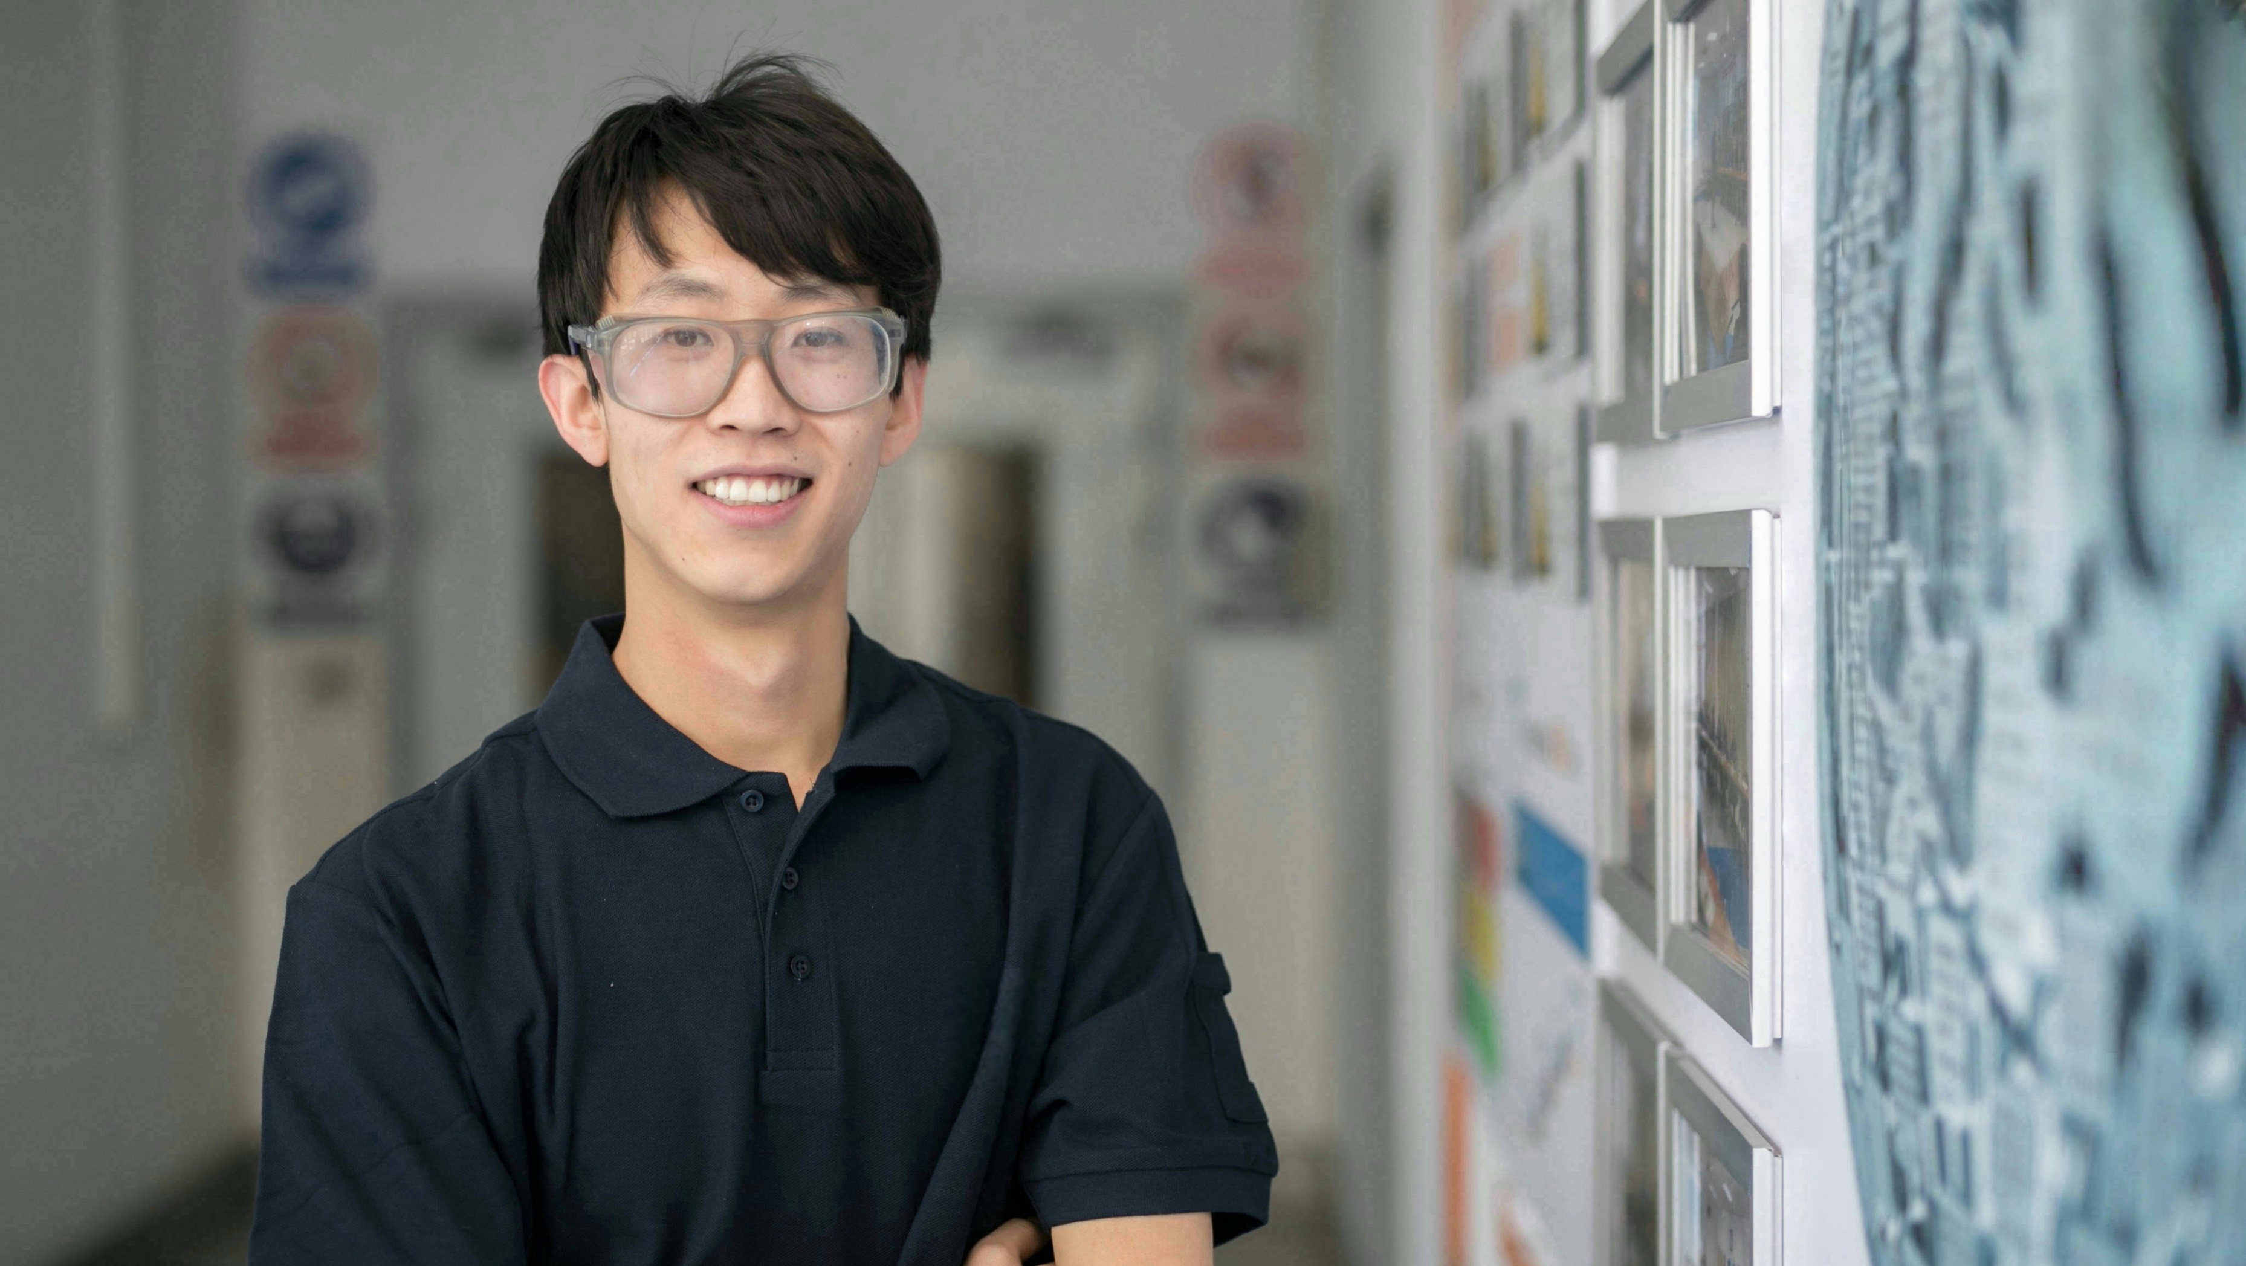




Learn more about how we’re Shaping the way we live and move 探索更多生活与出行的全新可能
英文网站(EN website)
中文网站(CN website)
微信公众号(WeChat)
视频号(Video Channel)

Slide 35



